Slide 1
AI Systems based on incomplete knowledge for health monitoring and diagnostics of equipment
Seventeenth International Conference
on Condition Monitoring and Asset Management CM2021
Virtual 14 – 18 June 2021
Alexey V. Kostyukov, PhD Sergey N. Boychenko, PhD
Notes:
Good afternoon dear colleagues!
I would like to present you my next report on the topic:

Slide 2
Implementation of technologies for dramatic reduction of operational costs by means of condition monitoring systems is a vital component of a modern production.
The most efficient way of decreasing operational costs is to use a modern technology for safe resource-saving operation based on stationary real-time AI condition monitoring systems.
2
www.dynamics.ru

Slide 3
The basic ways of improving the efficiency of implementation of condition monitoring systems:
- implement real-time systems ensuring constant monitoring of the most critical equipment;
- implement systems at all stages of equipment’s service life (acceptance test, operation and maintenance);
- implement comprehensive systems with a single software-and-hardware platform ensuring monitoring of various equipment (rotating and static);
- connect the systems into a corporate diagnostic network providing information on equipment’s condition to all services interested.
3
www.dynamics.ru

Slide 4
Efficiency of monitoring systems directly depends on timeliness and correctness of a failure detection. AI-based diagnostic systems prove to be the most efficient.
4
www.dynamics.ru

Slide 5
AI
AI based on knowledge –
ready to use
high reliability
AI based on Neural Network – training required
5
www.dynamics.ru
Notes:
Currently the term “Artificial Intelligence” is closely connected with the term “Neural network”.
An alternative approach towards building an AI-based diagnostic system presupposes application of a set of known rules, stored in a special knowledge database, which are used to make a conclusion on the equipment’s condition.

Slide 6
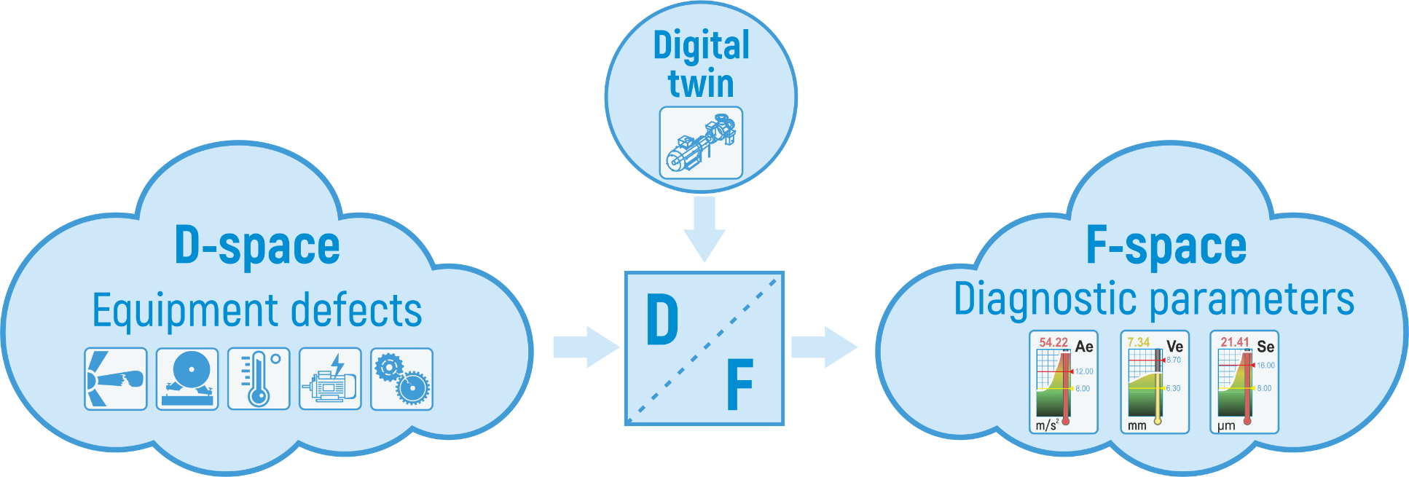
Operating principle of diagnostic systems with knowledge-based AI
6
www.dynamics.ru
Notes:
The main principle of the AI-based diagnostic system’s work is given on this slide.
The system generates a space filled with diagnostic parameters F, which is connected to the space filled with equipment defects D, by a conversion based on a digital twin of the monitored equipment.
The digital twin comprises of a set of knowledge and rules that determine the working procedure of the diagnostic system.
Thus approach has been used for many years and proves to be highly accurate, and, as opposed to neural network, requires no learning period.
All necessary rules already established by the new, not yet failed equipment.

Slide 7
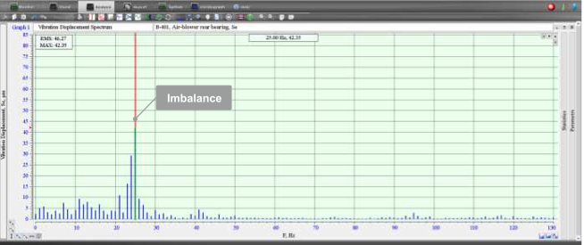
Vibration signal spectrum shown an “Imbalance defect“
7
www.dynamics.ru
Notes:
As an example let us consider a vibration signal spectrum obtained from a bearing support of a centrifugal pump (Figure on slide).
In this case the following rule is applied: “If the level of the first rotational harmonics of vibration velocity exceeds the set limit, issue the message: “Check for imbalance”.
This rule is considerable more reliable and efficient if compared to a learning neural network.
It is possible to give lots of similar examples, where use of the popular neural network approach is completely unjustified and may cause additional costs and failures.

Slide 8
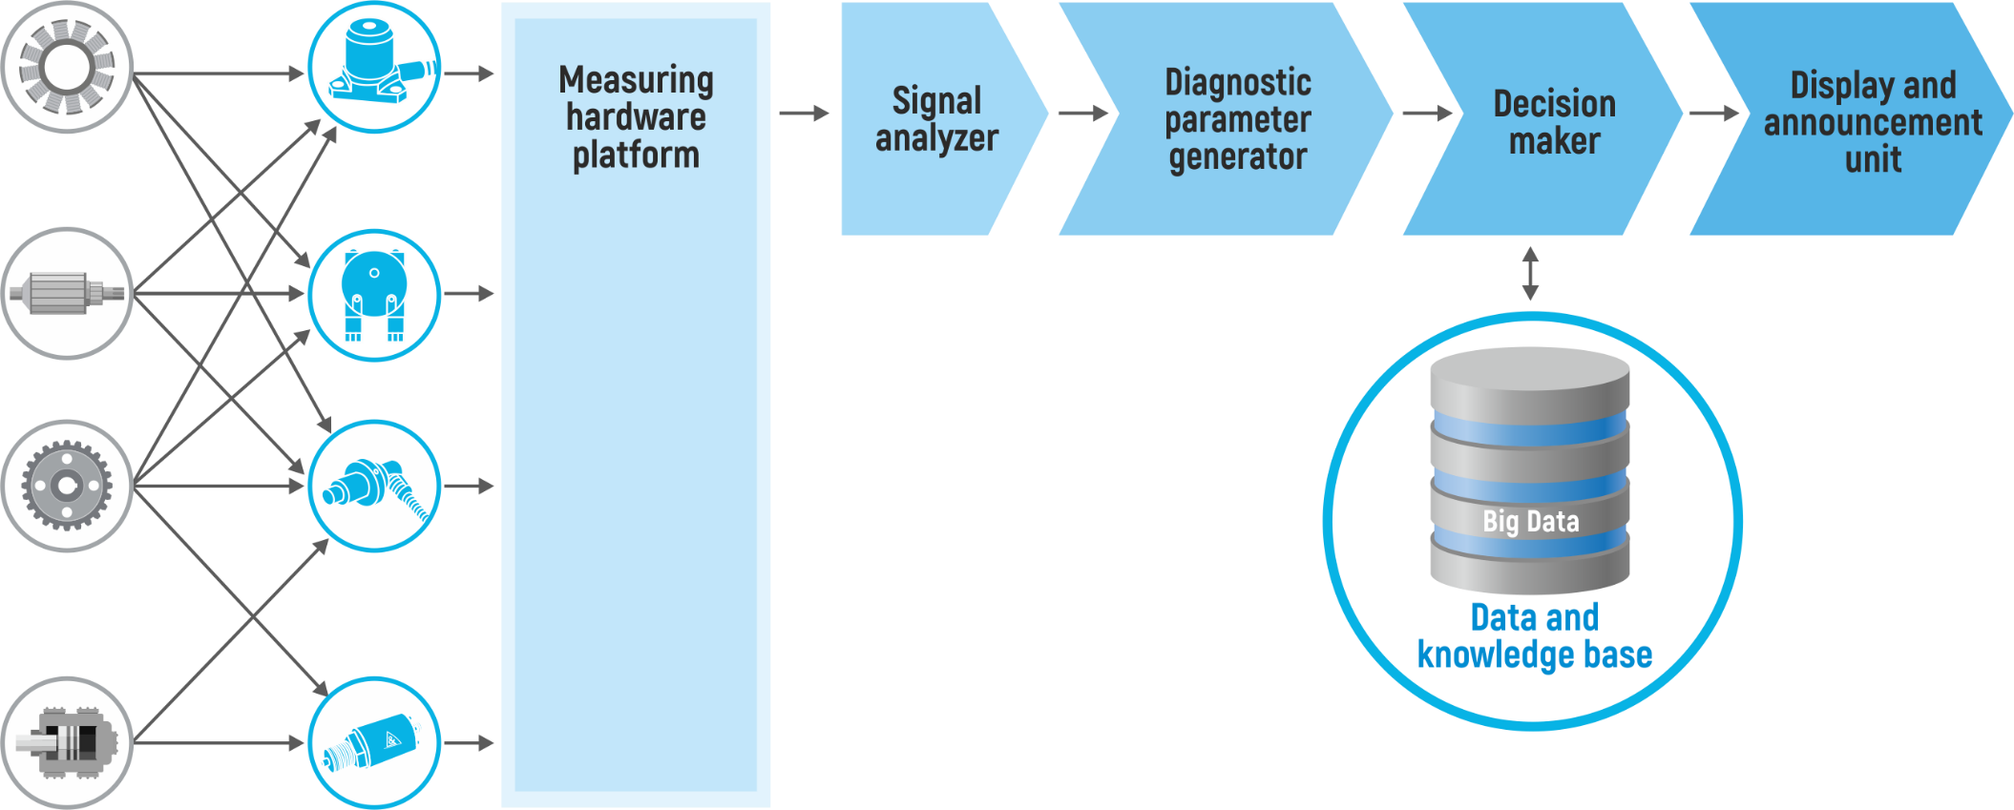
8
www.dynamics.ru
Notes:
The structural diagram of the diagnostic system with knowledge-based AI is shown on this slide.
Signals from sensors are sent to measuring hardware platform and then on signal analyzer and then Diagnostic parameter generator.
Further vector of diagnostic parameters are sent to Disition Maker unit and its result pass to Display and announcement unit.
Decstion maker unit use Data and Knowledge base where stored all diagnostic rules and parameters of equipment

Slide 9
Invariance to construction and operational procedure
Vector of invariant diagnostic parameters
Stage 1 - Invariant parameters for unknown construction and operational procedure are used
Vector of standard diagnostic parameters
Stage 2 - Parameters for known construction and operational procedure are used
9
www.dynamics.ru
Notes:
Important quality of diagnostic systems is invariance to construction and operational procedure.
Diagnostic systems for determining defects require precise information on equipment’s construction and operational procedure.
Lack or inaccuracy of such information may lead to diagnostic errors.
To implement this principle, the system generates a special vector of diagnostic parameters invariant to construction and operational procedure of the monitored equipment.
Examples of such parameters are parameters of characteristic function of vibration-acoustic signal, fractals. RMS and Peak values of vibration signal.
Decision rule using these papameters include two stages: 1 Parameters for unknown construction and operational procedure are used and 2 - standard diagnostic parameters are used
Rules based on such parameters are slightly less deep and credible, but they allow preventing accidents due to equipment’s failures and lack of accurate initial data.

Slide 10
Conclusion
Knowledge-based systems have the advantage of the ones based on neural networks when working with the known types of defects.
If there is not enough information on equipment’s construction and operational procedure it is important to use special invariant diagnostic parameters and two-stage algorithm of the decision-making unit’s work.
10
www.dynamics.ru

Slide 11
Thank You For Your Attention!
11
www.dynamics.ru

